Slide 1

Turkish Super League Attendance Rate Prediction
18.01.2025
Ahmet Utku Alkan / 040220116

Slide 2
PROBLEM
Predict the attendance in football matches are important for:
Economic plans for teams
Security planning
Observing football fans’ behaviors in Türkiye
The model aims to make an impact and predictions for occupancy rates.

Slide 3
Literature Review
Classical studies model attendance using linear or log-linear demand equations, emphasizing factors such as home team quality, outcome uncertainty, and derby effects[1]
Machine learning techniques, including tree-based boosting models, which have shown improved performance in leagues like the footbal leagues & NFL[2]
[1] J. García, P. Rodríguez, and A. Pérez, "Attendance at Spanish football matches: Evidence from the First Division," Applied Economics, vol. 44, no. 1, pp. 21–34, 2012.
[2] A. Arboretti, R. Montella, and S. Salini, "Forecasting stadium attendance using machine learning methods: Evidence from the National Football League," Expert Systems with Applications, vol. 189, pp. 116038, 2022.

Slide 4
My Specific Approach
Hybrid Model:
Rule-based statistical methods
Machine Learning Model – Gradient Boosting Regressor
I propose a hybrid model that combines rule-based statistical reasoning with a machine learning model. The rule-based layer uses historical averages derived from team matchups, league rankings, and derby information to provide stable and interpretable baseline predictions. On top of this, a Gradient Boosting Regressor is trained using encoded team identities and numerical features. The final occupancy prediction is obtained by combining the outputs of these two layers with predefined weights, balancing interpretability and predictive power.

Slide 5
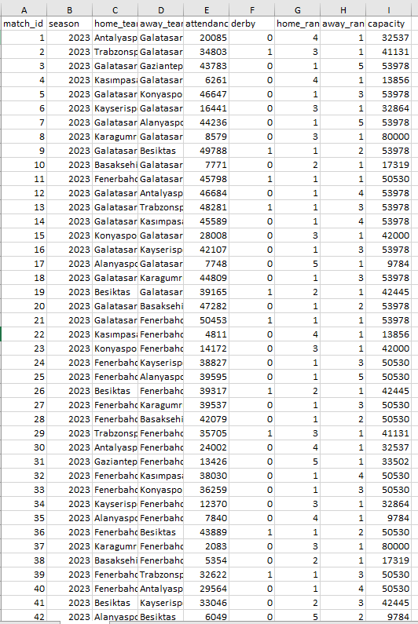
PROGRESS MADE
I have created my own dataset from Transfermarkt and TFF match informations. The excel data includes last 3 seasons in Turkish Super League and 506 matches.
In the figure; Excel file has 9 different categories
match_id: Match numbers to identify
season: Match played in which year (2022-23, 2023-24,2024-25)
home_team: The team that play in their own stadium
away_team: The team are hosted to home team
attendance: Number of spectators who came to watch the match
derby: The match is derby or not (1/0)
capacity: Maximum number of spectators allowed to watch the match
home_rank and away_rank: The position of the team after end of the season
RANKS
Rank 1: Championship Tier
Rank 2: Challenge for European Leagues
Rank 3: Middle-Higher
Rank 4: Middle-Lower
Rank 5: Relatation Battle

Slide 6
PROGRESS MADE
Progress Made:
Building Dataset
Implemented Feature Engineering
Full Prediction Pipeline
STRENGTHS:
2 different aproach with high accuracy
Enable user to enter any match and get the result
CHALLENGES:
The rank numbers do not change for the teams like Galatasaray and Fenerbahce because they were playing for the championship for the last 3 seasons

Slide 7
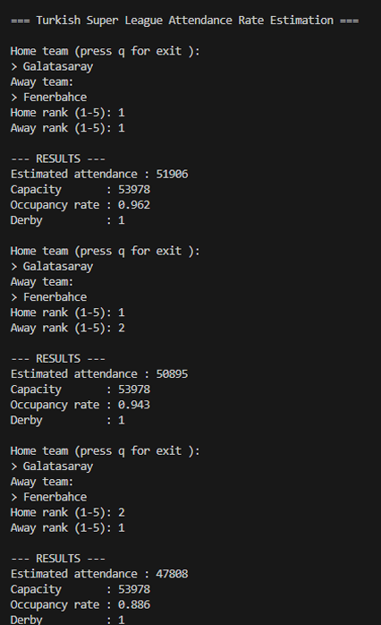
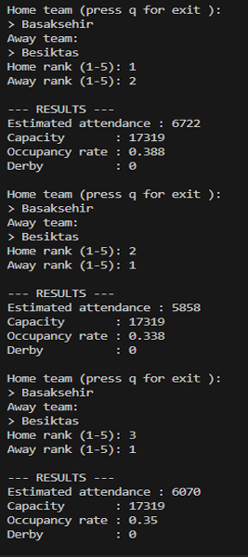
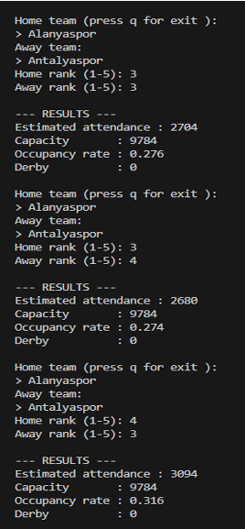
EXAMPLE OF PREDICTIONS

Slide 8
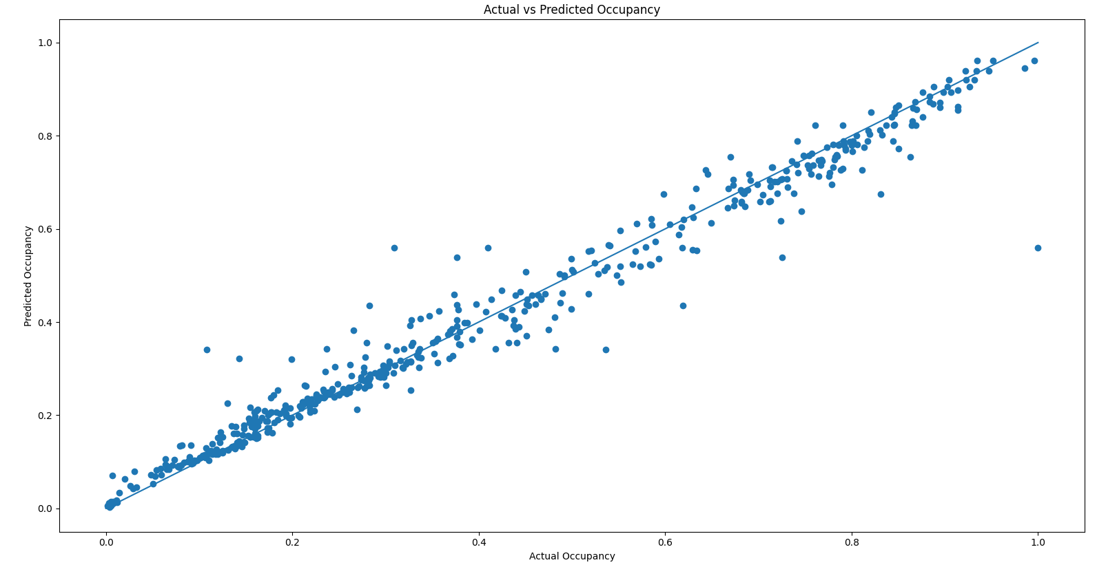
RESULTS & CONCLUSIONS
When the Actual vs Predicted Plot is examined, the predictions are close to their actual values especially in low occupancies.

Slide 9
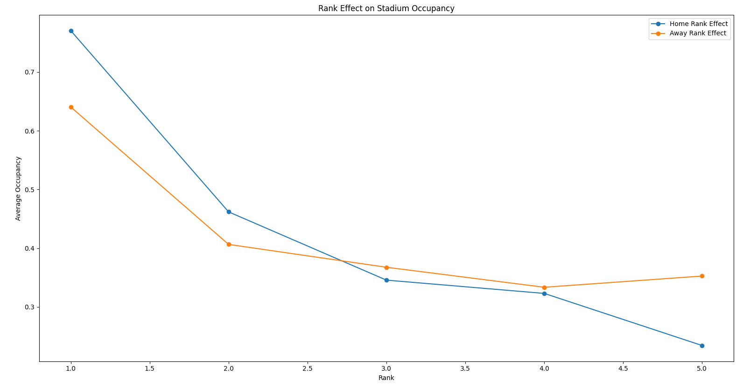
RESULTS & CONCLUSIONS
From the Rank Effect on Stadium Capacity, It is observed that for the well-positioned teams in standing; home team rank is more important. In contrast, for the middle-low level teams in standing, away team rank is more important.

Slide 10
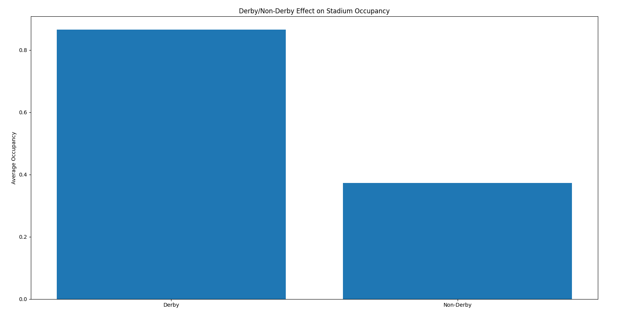
RESULTS & CONCLUSIONS
From the bar graph, Derby matches have almost 3 times higher occupancy than other matches.

Slide 11
CONCLUSIONS & FUTURE DIRECTIONS
CONCLUSIONS:
Thanks to rule-based and AI-based predictive modeling, the model can make predictions with high accuracy and low deviations.
For higher rankings in home team matches, fans consider home team rank more than away team rank.
Derby matches are much more preferred by fans.
FUTURE DIRECTIONS:
By examining the last 10 years instead of the last 3, the different ranking behaviors of teams like Galatasaray and Fenerbahçe can also be studied.

Slide 12
Turkish Super League Attendance Rate Prediction
18.01.2025

